Slide 1
Workshop 4:
Voluntary Sector Perspective
Maximising independence and early intervention for people who are newly diagnosed

Slide 2
People are all service users
Not just health and social care services
but a range of services in the community
including police, ambulance, fire service,
transport, housing, waste disposal, libraries,
shops, businesses, commerce, village and community halls, leisure services,
voluntary sector services etc.’
So, in other words, we are all ‘customers’ who need customer care

Slide 3
People live in Communities
People live in communities (localities)
Localities (neighbourhoods) have identities that have nothing to do with statutory organisational boundaries
Some are large, some small - all access a range of activities that could be statutory, voluntary, commercial – some well known, some active, some passive
Neighbourhoods are less stable & cohesive than 50 years ago – but can be responsive to stimulus
People are reliant on the local community and the community is reliant on the assets of its residents
Identifying and using the assets as well as the needs of residents leads to an active community with people who are healthier, more independent and less isolated

Slide 4
Voluntary Sector Perspective
What do we mean by
Voluntary and Community Sector
Independence
Prevention
Early Intervention
Government Priorities
Good support and the barriers
Integration and the barriers?
The customer
Early diagnosis

Slide 5
What is the Voluntary and Community Sector?
It is not one entity but several – not all are set up to support individuals – some are infrastructure organisations
It is:
  not statutory
  not NHS
  not Adult Services
  not simple
  It is:
  complex
  different
  varied
  flexible
  usually charitable but not necessarily a charity
It can be a social enterprise, a community Interest company or something different
It is not amateur – but composed of a varied range of skills & talents

Slide 6
What do we mean by Independence?
7 Dimensions of Independence - the whole person
  Income – financial security
  Information - right place, right time
  Getting out and about
  Social networks, being valued and able to participate and contribute to their community
  Housing and the home - every opportunity to remain independent – to make choices
  Neighbourhood - feeling safe & secure at home & in the community
  Health and healthy living

Slide 7
What do we mean by Prevention?
Prevention usually refers to the act of putting in place activities, actions or support to slow down or reduce the onset of disease, illness, isolation.
Prevention is always better than cure; that is why we have a moral mission to provide compassion and support as soon as problems emerge
Early referral or contact with the voluntary and community sector supports independence, prevents deterioration and reduces the need for hospital beds and health and social care services

Slide 8
What is early intervention?
A real opportunity to
  make lasting improvements in the lives of people
  forestall many persistent health/social problems
  make long-term savings in public spending.
  give people essential social, health & emotional security
It includes a range of possible solutions which leave people ready to face the challenges of each stage of their lives
It is available in the voluntary sector but less so from statutory orgs where it is patchy and dogged by institutional/financial obstacles.
Still a statutory bias in favour of late intervention even though these policies are known to be expensive and of limited success.
Need a cultural shift to ‘Early Intervention’ and requires new thinking on how to achieve it
Need evidence about which forms of ‘Early Intervention’ are most successful and about their impact.
Need an investment in resources for ‘Early Intervention’

Slide 9
Government priorities on healthcare 2008
Included
  Strengthen the power of GP’s to commission care for patients .
  Ensure that there is a stronger voice for patients
  Make the NHS work better - extend best practice, reduce delays to operations & enable community access to care/treatments.
  Help older people live at home for longer
  Enable patients to rate the quality of hospitals/doctors
  Require hospitals to be open about mistakes and what is wrong.
  Put patients in charge of making decisions about their care, including control of their health records.
  Continuous improvement of quality of services to patients - achieving this through greater involvement of independent/voluntary providers.”
  Locally developed solutions rather than a top-down, ‘one-size-fits-all’ approach to information systems.
  Integrated health & social care information for individuals (strong rumour)
Notes:
Strengthen the power of GP’s as patients’ expert guides through the health system by enabling them to commission care on their behalf.”
Ensure that there is a stronger voice for patients
Make the NHS work better by extending best practice on improving discharge from hospital, maximising numbers of day care operations, reducing delays prior to operations, & where possible enabling community access to care/treatments.
Help elderly people live at home for longer through solutions such as home adaptations and community support programmes.”
Enable patients to rate hospitals/doctors according to the quality of care received
Require hospitals to be open about mistakes & always tell patients if something has gone wrong.”
“We will put patients in charge of making decisions about their care, including control of their health records.”
Continuous improvement of the quality of services to patients, and achieving this through much greater involvement on independent and voluntary providers.”
Locally developed solutions rather than a top-down, ‘one-size-fits-all’ approach to information systems.
Integrated health & social care information for individuals (strong rumour

Slide 10
Nothing about us without us
People have the right to live their lives to the full as long as that
doesn’t stop others from doing the same.
We need to help people to have choice and control over their lives
Recognise that making a choice can involve some risk for the
  individual and for the authority
They should be involved from day one – not just when the
professional is ready to involve them
Respect people’s rights and those of their family carers
Consider that the ‘safest option’ or ‘most equal/equitable solution’
may not be necessarily the best option for the person & may be
detrimental to quality of life & a risk to maintaining independence
We need to involve service users and carers at every level and stage of a project, policy or procedure that affects them
Notes:
The slogan is not new (created 2001)
Use skills and assets – not needs
It reflects the views of most people with any disability, a medical condition, a frailty because of old age, a carer
The individual should be at the heart of any project or policy or procedure – they should be the catalyst for improvement and change, or the lever to prevent change for the sake of change.
Our choice and control – our right to take risks
People should be at the heart of any project or policy or procedure
People should be the catalyst for improvement and change
People should be involved from day one and at every stage
Care and Share Timebank

Slide 11
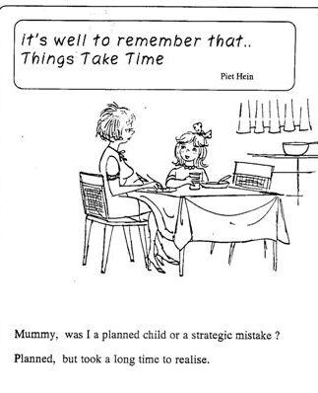
After 7 years……. we must not lose heart

Slide 12
How do we provide support?
Direct Support is provided by an organisation, service or group set up specifically to give support to the service user/carer. This can be in a range of different formats, methods and services but will have the primary aim of supporting the person with needs.
Indirect Support is provided by an organisation, service or group, statutory and/or voluntary, set up specifically to give support to people with disabilities, medical conditions or illnesses but which also give considerable support to carers (or vice versa), deliberately or by default, because of the support they give to the person for whom they are caring and the networks and information they establish.
Community Support is provided by a wide range of organisations, services & groups, statutory and/or voluntary, that provide a range of community facilities that people with long term conditions & carers can tap into as and when needed. These will not be specifically for people with disabilities or carers but will be available to any citizen on a basis of need e.g. advice, support, lunch clubs etc.
Carers Together Annual Report 2001

Slide 13
What are the barriers to effective support?
Labels - basically the barrier to receiving effective support is the perceived need for people to be labelled first.
Social Care is provided under the broad headings - Physical Impairment, Learning Disability, Sensory Loss, Mental Health, Older People (when did older people become a social care condition?)
Health Care is provided under the broad headings of illness, short/long term health condition.
This mixture of conditions, needs and age does not lend itself to efficient, effective ways of working, nor does it help people to work through their own real personal issues and the potential solutions.
Notes:
Individual with 16 care plans!!

Slide 14
Labels can prevent effective support?
People are labelled and cared-for rather than supported to develop and grow as individuals and this takes away opportunities to find potential innovative support they need and/or want.
It may mean that people’s own skills and talents are not recognised or used.
Service providers think and believe they own the information they hold in each individual and insist on having demographic and specialist information about every client in their own record system
People end up having a large number of records about them and repeating themselves over and over to each service provider (Say it Once)

Slide 15
Integration could be an answer
Recognising social and medical aspects of long-term conditions
Creating a set of tools for clinicians to use with patients to address behavioural & social aspects of long term conditions e.g. helping people to exercise more, eat more healthily, build strong social networks and feel supported & in control of their lives.
The clinician referring patients onto others who support them.
Recognising the importance of systematically linking to a variety of services that provide 'more than medicine'.
These services mobilise communities & networks to support people on their terms. They should be co-designed & co-delivered by patients, enabling them to meet not only medical needs but wider social, physical & mental wellbeing goals.
Alternative provision is not intended to replace traditional medical care, but to complement it by developing an infrastructure to reliably/consistently deliver models of support to enable people to live better.
promote community-based services into health and social care.

Slide 16
What do we mean by Integration?
Different ways to integrate and promote community-based services into health and social care (People Powered Health).
Key findings - three elements help the process:
Social prescribing - a clear, coherent and collaborative process in which healthcare practitioners work with patients and service users to select and make referrals to community-based services.
Signposting - new roles and support for people who help patients and service users understand, access and navigate community-based services that will improve their health.
Community - A balanced and healthy ecosystem of community-based services and providers so that a wide range of opportunities are available

Slide 17
What are the barriers to integration?
Different individuals with different needs & assets
Health and social care professionals believing they deal with the whole person and don’t need voluntary sector support
Lack of knowledge about the range of voluntary and community support available in each community or locality
All organisations thinking they can lead the support when the support should be provided around and with the individual customer

Slide 18
Who is the customer?
The one constant is the person who needs a service – the customer (patient, service user, carer, client)
Without customers we wouldn’t need a service and we wouldn’t need records
Customer care is the lynchpin of commercial services – they know their customers and provide what their customers want and need
Why do we assume in health and social care – that patients /service users/carers have no skills just needs?
Why do we assume that every person only needs support from health and social care?
Why do we talk about stakeholders – and not our customers
Notes:
Mrs Smith

Slide 19
What happens to people newly diagnosed with an illness or condition?
Shock
Fear
Loneliness/isolation
Disbelief
Who to talk to?
Where to go?
Getting time needed
Getting expertise needed
Starting difficult conversations
Where do they go for support

Slide 20
Responsive to customers
None of the health and social care services deal with the holistic person - who may have more than one condition, or may be dealing with other issues including family, work, housing, education, transport, community etc.
As a result people often do not know about the range of activities and services available to them in the local community and it may mean that people’s own skills and talents are not recognised or used.
Many repeat themselves over and over to no avail
Voluntary organisations often find themselves representing the service user and advocating for them
Notes:
Brilliant service from the OTs – sharing?
Mrs Smith

Slide 21
Local Voluntary Sector organisations
Are naturally inclined to help people and provide ‘early intervention’ through activities in the community – transport, clubs, leisure, hobbies, U3A, specialist condition specific organisations etc.
They can help because they are available. They may have:
  Specialist knowledge
  Time
  Expertise
  Flexibility
They are used to
  Sharing
  Caring
  Signposting
  Responding to local need
  Providing outlets for volunteering – using assets & reducing needs
How do you decide which organisation can help?
Condition specific organisations are great for people with those conditions – but many organisations can provide ‘that little bit of help’ that is needed

Slide 22
Voluntary doesn’t mean amateur
Volunteers and voluntary organisations
  are not amateur, inexperienced or unprofessional
  are not composed of unskilled volunteers
Many employ professionals to run them and work in them
Many volunteers have enormous experience, skills and knowledge
Many have retired from careers and use their experiences to offer service in the community
Services users/carers may also be volunteers and may have more knowledge than some of the professionals that are working with them
We must help people to use their own assets to improve their experiences and remain as independent as possible

Slide 23
Advantages of the Voluntary Sector
It is used to working in equal Partnership and understands the need to use all resources to get the right continuous support for individuals
It works and believes in Coproduction – ensuring the individual is at the heart of everything provided with them. The difference between coproduction and consultation is that coproduction is a continuous two way person centred relationship whereas consultation is a one way, statutory led process.
It is often local and person centred – and can respond quickly, flexibly and differently to changing need.
It can & does attract a wide range of skills/expertise & can offer informal expert support from birth to end of life
The important thing is good communication and networking

Slide 24
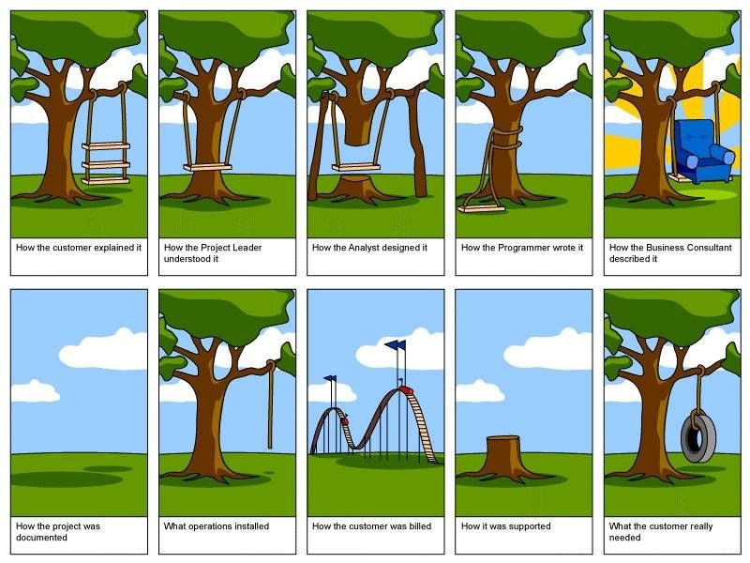
Finally - A cautionary tale…

